Slide 1
Bachelor‘s thesis
Machine Learning and EEG Classification
How Neural Networks Can Detect Epileptic Seizures
2018 | July 17th Seminar: Current Topics in Theoretical Neuroscience Thuy Nguyen

Slide 2
Table of Contents
Epilepsy
Neural Networks & Classification
Data
Models
Results
Conclusion
2018 | July 17th Seminar: Current Topics in Theoretical Neuroscience Thuy Nguyen

Slide 3
Epilepsy
2018 | July 17th Seminar: Current Topics in Theoretical Neuroscience Thuy Nguyen

Slide 4
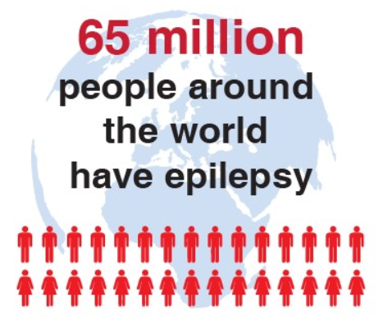
Epilepsy
Figure 1 | Epilepsy in Numbers („Seizure Alert Dogs“, n.d.)
What is Epilepsy?
at least two unprovoked seizures occurring >24 h apart
one unprovoked seizure and a probability of at least 60% of further seizures occurring over the next 10 years
2018 | July 17th Seminar: Current Topics in Theoretical Neuroscience Thuy Nguyen

Slide 5
Epilepsy
Figure 1 | Epilepsy in Numbers („Seizure Alert Dogs“, n.d.)
What is Epilepsy?
at least two unprovoked seizures occurring >24 h apart
one unprovoked seizure and a probability of at least 60% of further seizures occurring over the next 10 years
What is a Seizure?
temporary occurrence of pathological symptoms due to abnormal excessive or synchronous neuronal activity in the brain
generalized seizures or focal seizures
(Fisher et al., 2014)
2018 | July 17th Seminar: Current Topics in Theoretical Neuroscience Thuy Nguyen

Slide 6
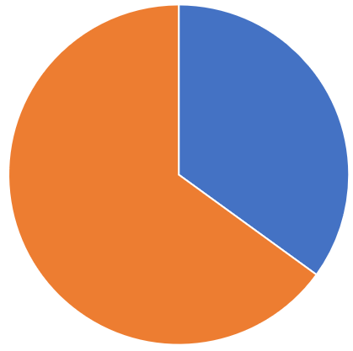
Epilepsy
Causes of Epilepsy
30 – 40 %: brain injuries, tumors, strokes, infections, etc.
60 – 70 %: unknown causes, many assumed to be genetic
Figure 2 | Causes of Epilepsy. Based on (Kao & Rao, 2012).
2018 | July 17th Seminar: Current Topics in Theoretical Neuroscience Thuy Nguyen

Slide 7
Epilepsy
Causes of Epilepsy
Treatment
30 – 40 %: brain injuries, tumors, strokes, infections, etc.
seizure medication
Epilepsy surgery
Neurostimulation
60 – 70 %: unknown causes, many assumed to be genetic
Figure 2 | Causes of Epilepsy. Based on (Kao & Rao, 2012).
2018 | July 17th Seminar: Current Topics in Theoretical Neuroscience Thuy Nguyen

Slide 8
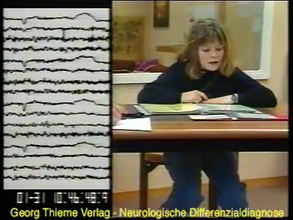
Epilepsy diagnosis with EEG
2018 | July 17th Seminar: Current Topics in Theoretical Neuroscience Thuy Nguyen

Slide 9
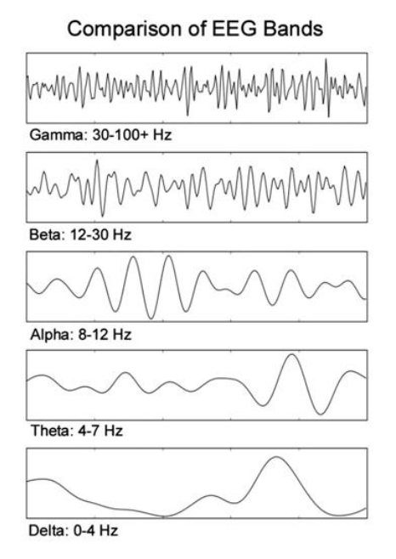
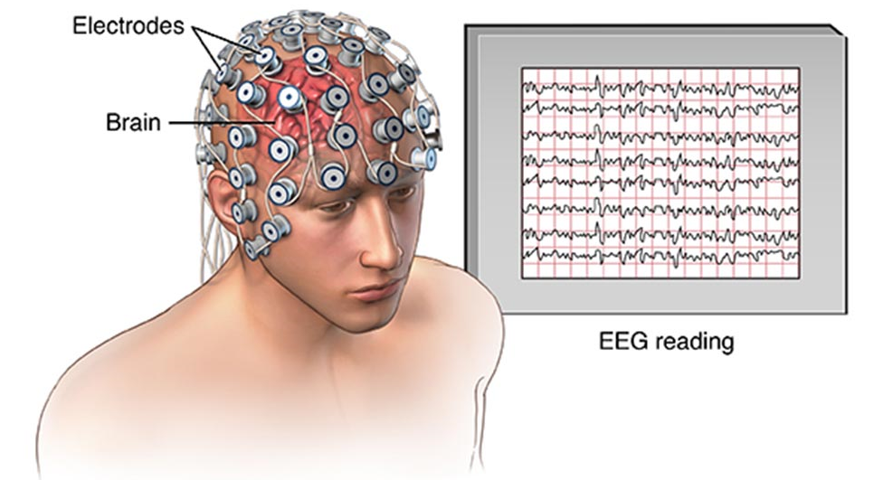
Epilepsy diagnosis with EEG
Figure 3 | EEG („EEG“, n.d.; „Greek Alphabet Soup – Making Sense of EEG Bands”, n.d.).
2018 | July 17th Seminar: Current Topics in Theoretical Neuroscience Thuy Nguyen

Slide 10
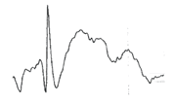
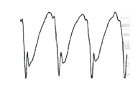
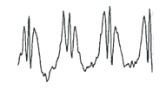
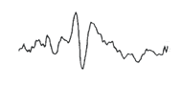
Epilepsy diagnosis with EEG
Spike
Polyspikes
Spike-wave-complex
Sharp wave
Figure 4 | Epilepsy Typical EEG Patterns (Staud, 2014)
2018 | July 17th Seminar: Current Topics in Theoretical Neuroscience Thuy Nguyen

Slide 11
Motivation
traditional method used for EEG classification: visual monitoring
state of the art in research: feature extraction first, then classification using machine learning techniques
2018 | July 17th Seminar: Current Topics in Theoretical Neuroscience Thuy Nguyen

Slide 12
Motivation
traditional method used for EEG classification: visual monitoring
state of the art in research: feature extraction first, then classification using machine learning techniques
my thesis: classification of EEG data without feature extraction using neural networks
comparison of performance of different network topologies
2018 | July 17th Seminar: Current Topics in Theoretical Neuroscience Thuy Nguyen

Slide 13
Related Research
dataset: publicly available database on the website of Bonn University
5 subsets with 100 segments of either EEG or iEEG recordings
sampling rate: 173.61 Hz
duration of each segment: 23.6 s
“Deep convolutional neural network for the automated detection and diagnosis of seizure using EEG signals”
classification of healthy, preictal, and seizure EEG
13-layer deep convolutional neural network
accuracy of 88.67%
(Acharya et al., 2017)
“Deep Recurrent Neural Networks for seizure detection and early seizure detection systems”
classification of healthy, interictal and seizure EEG
several types of recurrent neural networks
accuracy close to 100 %
(Talathi, 2017)
2018 | July 17th Seminar: Current Topics in Theoretical Neuroscience Thuy Nguyen

Slide 14
Related Research
dataset: publicly available database on the website of Bonn University
5 subsets with 100 segments of either EEG and iEEG recordings
sampling rate: 173.61 Hz
duration of each segment: 23.6 s
“Deep convolutional neural network for the automated detection and diagnosis of seizure using EEG signals”
classification of healthy, preictal, and seizure EEG
13-layer deep convolutional neural network
accuracy of 88.67%
(Acharya et al., 2017)
“Deep Recurrent Neural Networks for seizure detection and early seizure detection systems”
classification of healthy, interictal and seizure EEG
several types of recurrent neural networks
accuracy close to 100 %
(Talathi, 2017)
2018 | July 17th Seminar: Current Topics in Theoretical Neuroscience Thuy Nguyen

Slide 15
Related Research
dataset: publicly available database on the website of Bonn University
5 subsets with 100 segments of either EEG and iEEG recordings
sampling rate: 173.61 Hz
duration of each segment: 23.6 s
“Deep convolutional neural network for the automated detection and diagnosis of seizure using EEG signals”
classification of healthy, preictal, and seizure EEG
13-layer deep convolutional neural network
accuracy of 88.67%
(Acharya et al., 2017)
“Deep Recurrent Neural Networks for seizure detection and early seizure detection systems”
classification of healthy, interictal and seizure EEG
several types of recurrent neural networks
accuracy close to 100 %
(Talathi, 2017)
2018 | July 17th Seminar: Current Topics in Theoretical Neuroscience Thuy Nguyen

Slide 16
Neural Networks & Classification
2018 | July 17th Seminar: Current Topics in Theoretical Neuroscience Thuy Nguyen

Slide 17


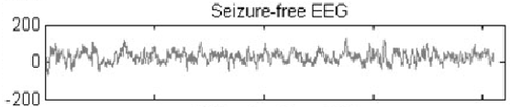



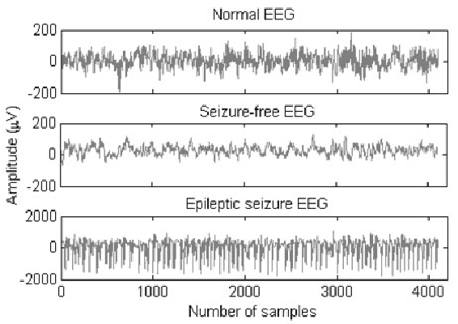
Classification
Figure 5 | EEG Classification (Ebrahimpour et al., 2012)
2018 | July 17th Seminar: Current Topics in Theoretical Neuroscience Thuy Nguyen

Slide 18
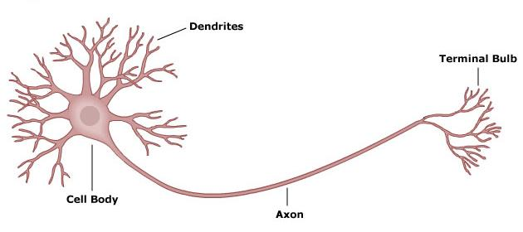
Neural Networks
Biological Background
Synapse
Figure 6 | A Biological Neuron. („Neuron illustration“, n.d.)
2018 | July 17th Seminar: Current Topics in Theoretical Neuroscience Thuy Nguyen

Slide 19
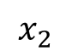
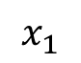
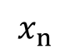
Neural Networks
Artificial Neuron
inputs
$$x_{1}$$
$$x_{2}$$
.
.
.
$$x_{n}$$
2018 | July 17th Seminar: Current Topics in Theoretical Neuroscience Thuy Nguyen

Slide 20
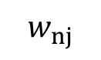
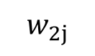
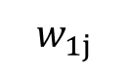
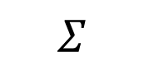
Neural Networks
Artificial Neuron
inputs
weights
$$x_{1}$$
$$w_{1j}$$
$$w_{2j}$$
$$x_{2}$$
$$Σ$$
.
.
.
$$w_{nj}$$
$$x_{n}$$
2018 | July 17th Seminar: Current Topics in Theoretical Neuroscience Thuy Nguyen

Slide 21
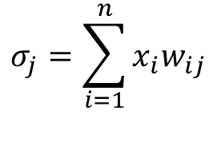
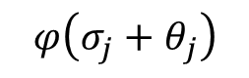
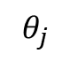

Neural Networks
Artificial Neuron
inputs
weights
$$x_{1}$$
$$w_{1j}$$
activation function
$$σ_{j}=\sum_{i=1}^{n}{x_{i}w_{ij}}$$
$$w_{2j}$$
$$x_{2}$$
$$Σ$$
$$φ\left(σ_{j}+θ_{j}\right)$$
.
.
.
$$w_{nj}$$
$$x_{n}$$
$$θ_{j}$$
$$x_{n}$$
bias
2018 | July 17th Seminar: Current Topics in Theoretical Neuroscience Thuy Nguyen

Slide 22
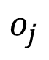
Neural Networks
Artificial Neuron
inputs
weights
$$x_{1}$$
$$w_{1j}$$
activation function
output
$$σ_{j}=\sum_{i=1}^{n}{x_{i}w_{ij}}$$
$$w_{2j}$$
$$x_{2}$$
$$Σ$$
$$φ\left(σ_{j}+θ_{j}\right)$$
$$o_{j}$$
.
.
.
$$w_{nj}$$
$$x_{n}$$
$$θ_{j}$$
$$x_{n}$$
bias
2018 | July 17th Seminar: Current Topics in Theoretical Neuroscience Thuy Nguyen

Slide 23
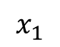
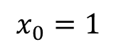
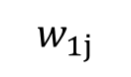

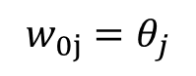
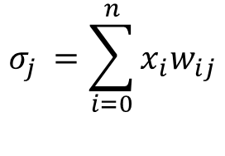
Neural Networks
Artificial Neuron
inputs
weights
$$x_{0}=1$$
$$w_{0j}=θ_{j}$$
activation function
output
$$σ_{j }=\sum_{i=0}^{n}{x_{i}w_{ij}}$$
$$w_{1j}$$
$$x_{1}$$
$$Σ$$
$$φ\left(σ_{j}\right)$$
$$o_{j}$$
.
.
.
$$w_{nj}$$
$$x_{n}$$
2018 | July 17th Seminar: Current Topics in Theoretical Neuroscience Thuy Nguyen

Slide 24
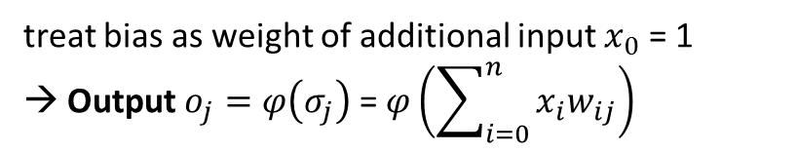
Neural Networks
Artificial Neuron
inputs
weights
$$x_{0}=1$$
$$w_{0j}=θ_{j}$$
activation function
output
$$σ_{j }=\sum_{i=0}^{n}{x_{i}w_{ij}}$$
$$w_{1j}$$
$$x_{1}$$
$$Σ$$
$$φ\left(σ_{j}\right)$$
$$o_{j}$$
.
.
.
$$w_{nj}$$
treat bias as weight of additional input $x_{0}$ = 1 → Output $o_{j}=φ\left(σ_{j}\right)$ = $φ\left(\sum_{i=0}^{n}{x_{i}w_{ij}}\right)$
$$x_{n}$$
2018 | July 17th Seminar: Current Topics in Theoretical Neuroscience Thuy Nguyen

Slide 25
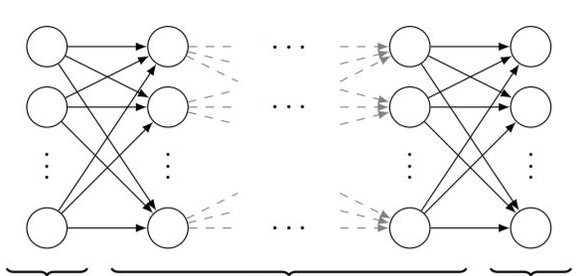
Supervised Learning
input
hidden
output
Figure 7 | Feed Forward Neural Network
2018 | July 17th Seminar: Current Topics in Theoretical Neuroscience Thuy Nguyen

Slide 26
Supervised Learning
labeled inputs
weights initialized randomly
if output does not match input label: change weights
repeat until stopping criterion is satisfied
input
hidden
output
Figure 7 | Feed Forward Neural Network
2018 | July 17th Seminar: Current Topics in Theoretical Neuroscience Thuy Nguyen

Slide 27
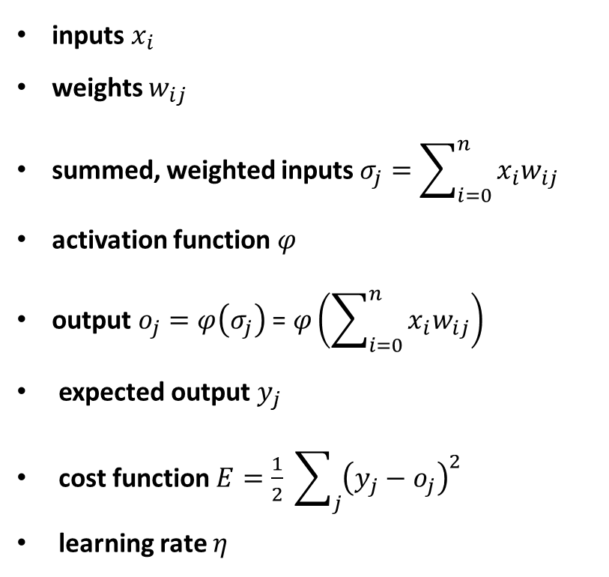
Backpropagation
inputs $x_{i}$
weights $w_{ij}$
summed, weighted inputs $σ_{j}=\sum_{i=0}^{n}{x_{i}w_{ij}}$
activation function $φ$
output $o_{j}=φ\left(σ_{j}\right)$ = $φ\left(\sum_{i=0}^{n}{x_{i}w_{ij}}\right)$
expected output $y_{j}$
cost function $E=\frac{1}{2} \sum_{j}{{\left(y_{j}−o_{j}\right)}^{2}}$
learning rate $η$
2018 | July 17th Seminar: Current Topics in Theoretical Neuroscience Thuy Nguyen

Slide 28
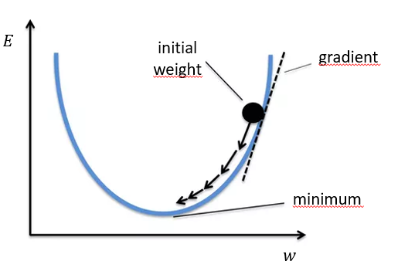
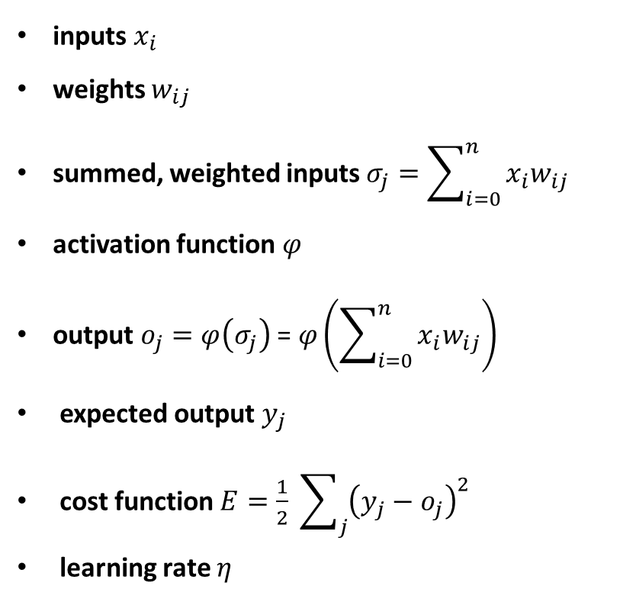
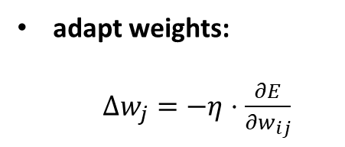
Backpropagation
inputs $x_{i}$
weights $w_{ij}$
summed, weighted inputs $σ_{j}=\sum_{i=0}^{n}{x_{i}w_{ij}}$
activation function $φ$
output $o_{j}=φ\left(σ_{j}\right)$ = $φ\left(\sum_{i=0}^{n}{x_{i}w_{ij}}\right)$
expected output $y_{j}$
cost function $E=\frac{1}{2} \sum_{j}{{\left(y_{j}−o_{j}\right)}^{2}}$
learning rate $η$
Figure 8 | Gradient Descent („Gradient Descent: All You Need to Know”, n.d.)
adapt weights:
$Δw_{j}=−η⋅\frac{∂E}{∂w_{ij}}$
2018 | July 17th Seminar: Current Topics in Theoretical Neuroscience Thuy Nguyen

Slide 29
Data
2018 | July 17th Seminar: Current Topics in Theoretical Neuroscience Thuy Nguyen

Slide 30
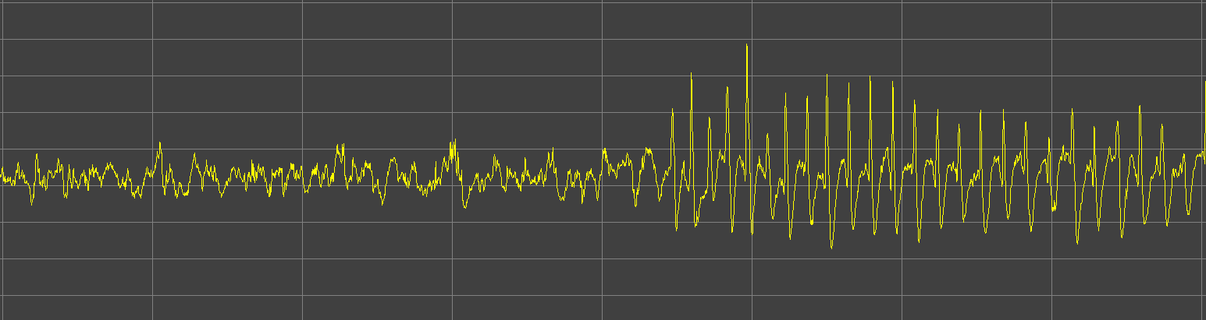
Data
data provided by Valentin Neubert (Philipps-University Marburg / Epilepsy Center Frankfurt Rhine-Main)
24h of iEEG of an epileptic rat
Figure 9 | 8 Seconds of iEEG
2018 | July 17th Seminar: Current Topics in Theoretical Neuroscience Thuy Nguyen

Slide 31
Prepocessing
segment data into 4-sec-parts
input size: 2048 sampling rate: 512 Hz
270 seizure segments
270 non-seizure segments
label data
normalize data
Non-seizure
Seizure
Figure 9 | 8 Seconds of iEEG
2018 | July 17th Seminar: Current Topics in Theoretical Neuroscience Thuy Nguyen

Slide 32
Prepocessing
segment data into 4-sec-parts
input size: 2048 sampling rate: 512 Hz
270 seizure segments
270 non-seizure segments
label data
normalize data
Non-seizure
Seizure
Figure 10 | Segmented Data
2018 | July 17th Seminar: Current Topics in Theoretical Neuroscience Thuy Nguyen

Slide 33
Prepocessing
segment data into 4-sec-parts
input size: 2048 sampling rate: 512 Hz
270 seizure segments
270 non-seizure segments
label data
normalize data
Non-seizure
Seizure
Figure 10 | Segmented Data
2018 | July 17th Seminar: Current Topics in Theoretical Neuroscience Thuy Nguyen

Slide 34
Prepocessing
segment data into 4-sec-parts
input size: 2048 sampling rate: 512 Hz
270 seizure segments
270 non-seizure segments
label data
normalize data
270 x Non-seizure
270 x Seizure
Figure 10 | Segmented Data
2018 | July 17th Seminar: Current Topics in Theoretical Neuroscience Thuy Nguyen

Slide 35
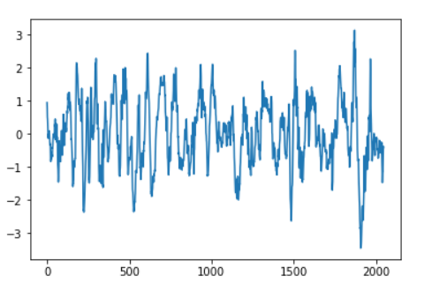
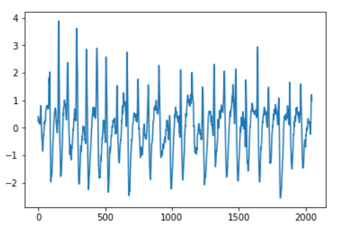
Prepocessing
segment data into 4-sec-parts
input size: 2048 sampling rate: 512 Hz
270 seizure segments
270 non-seizure segments
label data
normalize data
Figure 11 | Normalized Input Segments
2018 | July 17th Seminar: Current Topics in Theoretical Neuroscience Thuy Nguyen

Slide 36
Models
2018 | July 17th Seminar: Current Topics in Theoretical Neuroscience Thuy Nguyen

Slide 37
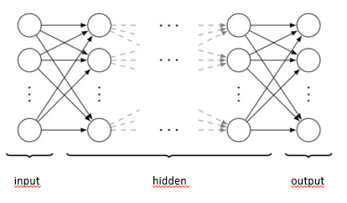
Models
Fully Connected Neural Network
1-dimensional input
multiple layers of neurons, interconnected in a feed-forward way
each neuron in one layer has directed connections to all the neurons of the subsequent layer
input
hidden
output
2018 | July 17th Seminar: Current Topics in Theoretical Neuroscience Thuy Nguyen

Slide 38
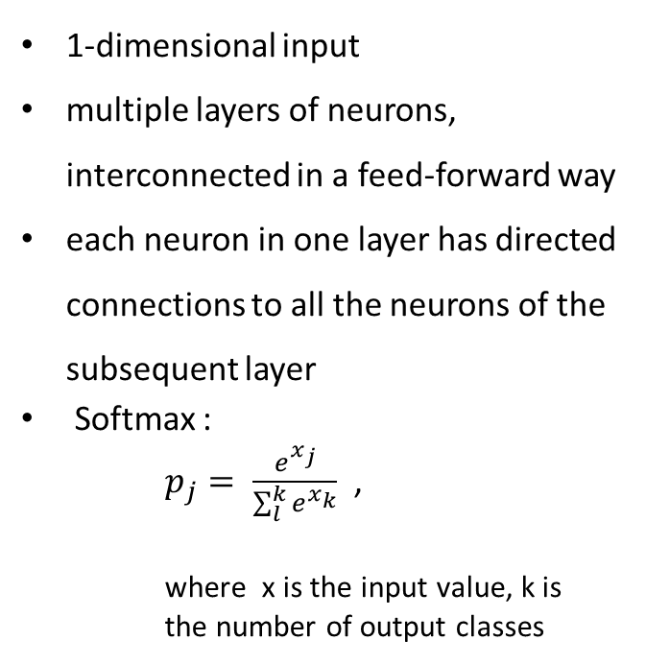
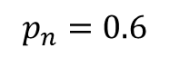
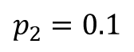
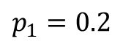
Models
Fully Connected Neural Network
$$p_{1}=0.2$$
1-dimensional input
multiple layers of neurons, interconnected in a feed-forward way
each neuron in one layer has directed connections to all the neurons of the subsequent layer
Softmax :
$p_{j}= \frac{e^{x_{j}}}{\sum_{l}^{k}{e^{x_{k}}}}$ ,
where x is the input value, k is the number of output classes
$$p_{2}=0.1$$
$$p_{n}=0.6$$
input
hidden
output
2018 | July 17th Seminar: Current Topics in Theoretical Neuroscience Thuy Nguyen

Slide 39
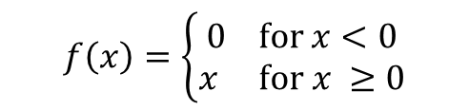
Models
Fully Connected Neural Network
Input
input: 270 segments of seizure and non-seizure signal respectively
activation function: ReLU
activation function: Softmax
Fully connected
$$f\left(x\right)=\left\{\begin{aligned}0 for x<0 \\ x for x ≥0\end{aligned}\right.$$
Output
Seizure
Non-Seizure
Figure 12 | Fully Connected Network Architecture
2018 | July 17th Seminar: Current Topics in Theoretical Neuroscience Thuy Nguyen

Slide 40
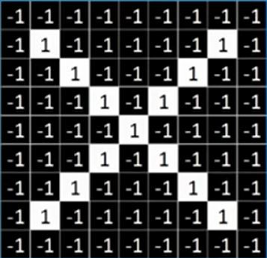
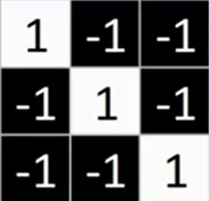

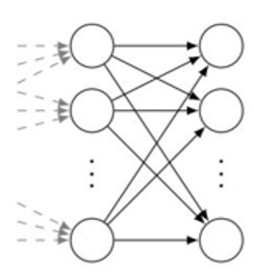
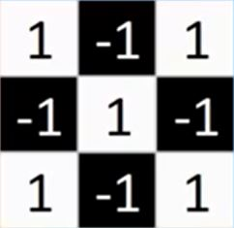
Models
Convolutional Neural Network
Figure 13 | Layers in a Convolutional Neural Network. Based on (Rohrer, 2016).
input can have more than one dimension
convolutional layer detects patterns
pooling layer reduces input size
fully connected layer
2018 | July 17th Seminar: Current Topics in Theoretical Neuroscience Thuy Nguyen

Slide 41
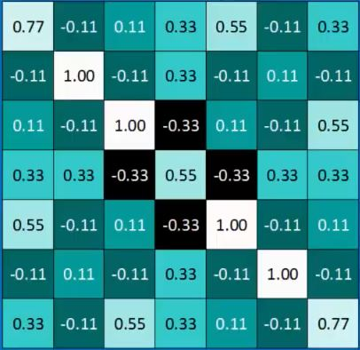
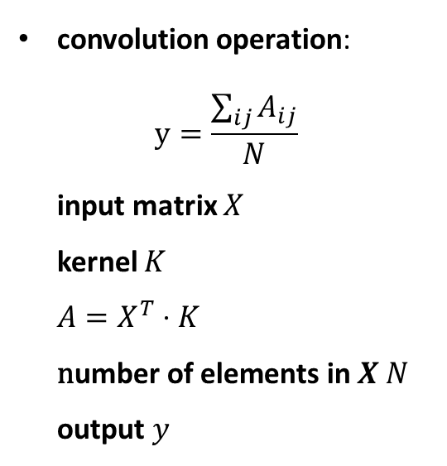
Models
Convolutional Neural Network – Filtering
convolution operation: $y=\frac{\sum_{ij}{A_{ij}}}{N}$ input matrix $X$ kernel $K$ $A=X^{T}⋅K$ $\text{n}\text{umber} \text{of} \text{elements} \text{in} X N$ output $y$
Figure 14 | Input Example (Rohrer, 2016)
Figure 15 | Filtering Output (Rohrer, 2016)
2018 | July 17th Seminar: Current Topics in Theoretical Neuroscience Thuy Nguyen

Slide 42
Models
Convolutional neural network - Filtering
convolution operation: $y=\frac{\sum_{ij}{A_{ij}}}{N}$ input matrix $X$ kernel $K$ $A=X^{T}⋅K$ $\text{n}\text{umber} \text{of} \text{elements} \text{in} X N$ output $y$
Figure 14 | Input Example (Rohrer, 2016)
Figure 15 | Filtering Output (Rohrer, 2016)
2018 | July 17th Seminar: Current Topics in Theoretical Neuroscience Thuy Nguyen

Slide 43
Models
Convolutional Neural Network – Filtering
convolution operation: $y=\frac{\sum_{ij}{A_{ij}}}{N}$ input matrix $X$ kernel $K$ $A=X^{T}⋅K$ $\text{n}\text{umber} \text{of} \text{elements} \text{in} X N$ output $y$
Figure 14 | Input Example (Rohrer, 2016)
Figure 15 | Filtering Output (Rohrer, 2016)
2018 | July 17th Seminar: Current Topics in Theoretical Neuroscience Thuy Nguyen

Slide 44
Models
Convolutional Neural Network – Filtering
convolution operation: $y=\frac{\sum_{ij}{A_{ij}}}{N}$ input matrix $X$ kernel $K$ $A=X^{T}⋅K$ $\text{n}\text{umber} \text{of} \text{elements} \text{in} X N$ output $y$
Figure 14 | Input Example (Rohrer, 2016)
Figure 15 | Filtering Output (Rohrer, 2016)
2018 | July 17th Seminar: Current Topics in Theoretical Neuroscience Thuy Nguyen

Slide 45
Models
Convolutional Neural Network – Filtering
convolution operation: $y=\frac{\sum_{ij}{A_{ij}}}{N}$ input matrix $X$ kernel $K$ $A=X^{T}⋅K$ $\text{n}\text{umber} \text{of} \text{elements} \text{in} X N$ output $y$
Figure 14 | Input Example (Rohrer, 2016)
Figure 15 | Filtering Output (Rohrer, 2016)
2018 | July 17th Seminar: Current Topics in Theoretical Neuroscience Thuy Nguyen

Slide 46
Models
Convolutional Neural Network – Filtering
convolution operation: $y=\frac{\sum_{ij}{A_{ij}}}{N}$ input matrix $X$ kernel $K$ $A=X^{T}⋅K$ $\text{n}\text{umber} \text{of} \text{elements} \text{in} X N$ output $y$
Figure 14 | Input Example (Rohrer, 2016)
Figure 15 | Filtering Output (Rohrer, 2016)
2018 | July 17th Seminar: Current Topics in Theoretical Neuroscience Thuy Nguyen

Slide 47
Models
Convolutional Neural Network – Filtering
convolution operation: $y=\frac{\sum_{ij}{A_{ij}}}{N}$ input matrix $X$ kernel $K$ $A=X^{T}⋅K$ $\text{n}\text{umber} \text{of} \text{elements} \text{in} X N$ output $y$
Figure 14 | Input Example (Rohrer, 2016)
Figure 15 | Filtering Output (Rohrer, 2016)
2018 | July 17th Seminar: Current Topics in Theoretical Neuroscience Thuy Nguyen

Slide 48
Models
Convolutional Neural Network – Filtering
convolution operation: $y=\frac{\sum_{ij}{A_{ij}}}{N}$ input matrix $X$ kernel $K$ $A=X^{T}⋅K$ $\text{n}\text{umber} \text{of} \text{elements} \text{in} X N$ output $y$
Figure 14 | Input Example (Rohrer, 2016)
Figure 15 | Filtering Output (Rohrer, 2016)
2018 | July 17th Seminar: Current Topics in Theoretical Neuroscience Thuy Nguyen

Slide 49
Models
Convolutional Neural Network – Filtering
convolution operation: $y=\frac{\sum_{ij}{A_{ij}}}{N}$ input matrix $X$ kernel $K$ $A=X^{T}⋅K$ $\text{n}\text{umber} \text{of} \text{elements} \text{in} X N$ output $y$
Figure 14 | Input Example (Rohrer, 2016)
Figure 15 | Filtering Output (Rohrer, 2016)
2018 | July 17th Seminar: Current Topics in Theoretical Neuroscience Thuy Nguyen

Slide 50
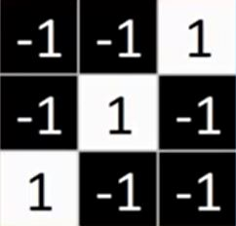
Models
Convolutional Neural Network – Filtering
Figure 14 | Input Example (Rohrer, 2016)
Figure 15 | Filtering Output (Rohrer, 2016)
2018 | July 17th Seminar: Current Topics in Theoretical Neuroscience Thuy Nguyen

Slide 51


Models
Convolutional Neural Network – Pooling
pooling operation: $p_{i}=max⁡(S_{ij})$ input $S$
Figure 16 | Pooling Output (Rohrer, 2016)
2018 | July 17th Seminar: Current Topics in Theoretical Neuroscience Thuy Nguyen

Slide 52
Models
Convolutional Neural Network – Pooling
pooling operation: $p_{i}=max⁡(S_{ij})$ input $S$
Figure 16 | Pooling Output (Rohrer, 2016)
2018 | July 17th Seminar: Current Topics in Theoretical Neuroscience Thuy Nguyen

Slide 53
Models
Convolutional Neural Network – Pooling
pooling operation: $p_{i}=max⁡(S_{ij})$ input $S$
Figure 16 | Pooling Output (Rohrer, 2016)
2018 | July 17th Seminar: Current Topics in Theoretical Neuroscience Thuy Nguyen

Slide 54
Models
Convolutional Neural Network – Pooling
pooling operation: $p_{i}=max⁡(S_{ij})$ input $S$
Figure 16 | Pooling Output (Rohrer, 2016)
2018 | July 17th Seminar: Current Topics in Theoretical Neuroscience Thuy Nguyen

Slide 55


Models
Convolutional Neural Network – Output
X
.
.
.
O
Figure 17 | Fully Connected Layer. Based on (Rohrer, 2016)
2018 | July 17th Seminar: Current Topics in Theoretical Neuroscience Thuy Nguyen

Slide 56
Models
Convolutional Neural Network
Input
← input: 270 segments of seizure and non-seizure signal respectively
← activation: ReLU
← maxPooling
activation: Softmax
Conv
Pooling
Fully connected
Output
Seizure
Non-Seizure
Figure 18 | Convolutional Network Architecture
2018 | July 17th Seminar: Current Topics in Theoretical Neuroscience Thuy Nguyen

Slide 57
Results
2018 | July 17th Seminar: Current Topics in Theoretical Neuroscience Thuy Nguyen

Slide 58
Early Results
parameters:
training-testing-ratio: 9 to 1
learning rate: 0.0001
number of epochs: 30
batch size: 64
Figure 19 | Accuracy of Classification using a Fully Connected Network
2018 | July 17th Seminar: Current Topics in Theoretical Neuroscience Thuy Nguyen

Slide 59
Early Results
parameters:
training-testing-ratio: 9 to 1
learning rate: 0.0001
number of epochs: 30
batch size: 64
stride of convolution: 2
stride of pooling: 1
2 fully connected layers at the end
Figure 20 | Accuracy of Classification using a Convolutional Network
2018 | July 17th Seminar: Current Topics in Theoretical Neuroscience Thuy Nguyen

Slide 60
Discussion Part I
Findings: training accuracy very high, testing accuracy much lower
2018 | July 17th Seminar: Current Topics in Theoretical Neuroscience Thuy Nguyen

Slide 61
Discussion Part I
Findings: training accuracy very high, testing accuracy much lower
possible reasons:
parameters not well-chosen
network structure unsuitable for the task
overfitting
2018 | July 17th Seminar: Current Topics in Theoretical Neuroscience Thuy Nguyen

Slide 62
Discussion Part I
Findings: training accuracy very high, testing accuracy much lower
possible reasons:
parameters not well-chosen
network structure unsuitable for the task
overfitting
possible solutions:
trial and error
try recurrent neural networks
reduce complexity of the model get more input data use dropout or batch normalization
2018 | July 17th Seminar: Current Topics in Theoretical Neuroscience Thuy Nguyen

Slide 63
Adding Dropout
Fully Connected Neural Network
Convolutional Neural Network
Input
Input
Conv
Fully connected
Pooling
Dropout
Fully connected
Output
Dropout
Output
Seizure
Non-Seizure
Seizure
Non-Seizure
Figure 21 | Fully Connected Network with Dropout
Figure 22 | Convolutional Network with Dropout
2018 | July 17th Seminar: Current Topics in Theoretical Neuroscience Thuy Nguyen

Slide 64
Current Results
Figure 23 | Accuracy of Classification using a Fully Connected Network with Dropout
2018 | July 17th Seminar: Current Topics in Theoretical Neuroscience Thuy Nguyen

Slide 65
Current Results
Figure 24 | Accuracy of Classification using a Convolutional Network with Dropout
2018 | July 17th Seminar: Current Topics in Theoretical Neuroscience Thuy Nguyen

Slide 66
Discussion Part II
Findings:
overfitting solved
fully connected network: poor performace
convolutional network: very good results
2018 | July 17th Seminar: Current Topics in Theoretical Neuroscience Thuy Nguyen

Slide 67
Discussion Part II
Findings:
overfitting solved
fully connected network: poor performace
convolutional network: very good results
Possible reasons:
fully connected network not complex enough for the task
convolutional network suitable
input very clear
2018 | July 17th Seminar: Current Topics in Theoretical Neuroscience Thuy Nguyen

Slide 68
Conclusion
2018 | July 17th Seminar: Current Topics in Theoretical Neuroscience Thuy Nguyen

Slide 69
Conclusion
Studies have already shown great results at classifying EEG data.
Fully connected neural networks are not suitable for EEG classification.
Convolutional networks do a good job on the classification.
2018 | July 17th Seminar: Current Topics in Theoretical Neuroscience Thuy Nguyen

Slide 70
Conclusion
Studies have already shown great results at classifying EEG data.
Fully connected neural networks are not suitable for EEG classification.
Convolutional networks do a good job on the classification.
Next steps:
try classification using different input data
try out recurrent neural networks
work with continuous data
2018 | July 17th Seminar: Current Topics in Theoretical Neuroscience Thuy Nguyen

Slide 71
References
2018 | July 17th Seminar: Current Topics in Theoretical Neuroscience Thuy Nguyen

Slide 72
References
Acharya, U.R., Oh, S.L., Hagiwara, Y., Tan, J.H., & Adeli, H. (2017). Deep convolutional neural network for the automated detection and diagnosis of seizure using EEG signals. Computers in Biology and Medicine, doi: 10.1016/j.compbiomed.2017.09.017.
Fisher, R.S., Acevedo, C., Arzimanoglou, A., Bogacz, A., Cross, H.J., Elger, C.E., Engel, J., Forsgren, L., French, J.A., Glynn, M., Hesdorffer, D.C., Lee, B.I., Mathern, G.W., Mosh, S.L., Perucca, E., Scheffer, I.E., Tomson, T., Watanabe, M., & Wiebe, S. (2014). A practical clinical definition of epilepsy. Epilepsia, 55(4), 475–482.
Kao, A., & Rao, P.M. (2012). Chapter 13 - Idiopathic generalized epilepsies. Handbook of Clinical Neurology, 107, 209-224.
Talathi, S. (2017). Deep Recurrent Neural Networks for seizure detection and early seizure detection systems. doi:10.2172/1366924.
2018 | July 17th Seminar: Current Topics in Theoretical Neuroscience Thuy Nguyen

Slide 73
Thank You For Your Attention
2018 | July 17th Seminar: Current Topics in Theoretical Neuroscience Thuy Nguyen

Slide 74
Additional Slides
2018 | July 17th Seminar: Current Topics in Theoretical Neuroscience Thuy Nguyen

Slide 75

Neural Networks
Backpropagation
Idea: Use Gradient Descent to optimize network output
$E=\frac{1}{2} \sum_{j}{{\left(y_{j}−o_{j}\right)}^{2}}=$ $\frac{1}{2} \sum_{j}{{\left(y_{j}−{φ(σ}_{j})\right)}^{2}}$
$=$ $\frac{1}{2} \sum_{j}{{\left(y_{j}−{φ(\sum_{i}{x}}_{i}w_{ji})\right)}^{2}}$
2018 | July 17th Seminar: Current Topics in Theoretical Neuroscience Thuy Nguyen

Slide 76

Neural Networks
Backpropagation
Idea: Use Gradient Descent to optimize network output
Minimize Cost function $E$: $\frac{∂E}{∂w_{ji}}=\frac{∂E}{∂σ_{j}}⋅\frac{∂σ_{j}}{w_{ji}}$
$=\frac{∂E}{∂σ_{j}}⋅\frac{∂}{∂w_{ji}}{\sum_{i}{x}}_{i}w_{ji}$
$=\frac{∂E}{∂σ_{j}}⋅$ $o_{j}$
$={−δ}_{j}⋅$ $o_{j}$ , with ${−δ}_{j}$ $=\frac{∂E}{∂σ_{j}}$
$E=\frac{1}{2} \sum_{j}{{\left(y_{j}−o_{j}\right)}^{2}}=$ $\frac{1}{2} \sum_{j}{{\left(y_{j}−{φ(σ}_{j})\right)}^{2}}$
$=$ $\frac{1}{2} \sum_{j}{{\left(y_{j}−{φ(\sum_{i}{x}}_{i}w_{ji})\right)}^{2}}$
2018 | July 17th Seminar: Current Topics in Theoretical Neuroscience Thuy Nguyen

Slide 77

Neural Networks
Backpropagation
Idea: Use Gradient Descent to optimize network output
Minimize Cost function $E$: $\frac{∂E}{∂w_{ji}}=\frac{∂E}{∂σ_{j}}⋅\frac{∂σ_{j}}{w_{ji}}$
$=\frac{∂E}{∂σ_{j}}⋅\frac{∂}{∂w_{ji}}{\sum_{i}{x}}_{i}w_{ji}$
$=\frac{∂E}{∂σ_{j}}⋅$ $o_{j}$
$={−δ}_{j}⋅$ $o_{j}$ , with ${−δ}_{j}$ $=\frac{∂E}{∂σ_{j}}$
Adopt weights: $Δw_{j}=−η⋅\frac{∂E}{∂w_{ji}}=η⋅δ_{j}⋅o_{j}$
$E=\frac{1}{2} \sum_{j}{{\left(y_{j}−o_{j}\right)}^{2}}=$ $\frac{1}{2} \sum_{j}{{\left(y_{j}−{φ(σ}_{j})\right)}^{2}}$
$=$ $\frac{1}{2} \sum_{j}{{\left(y_{j}−{φ(\sum_{i}{x}}_{i}w_{ji})\right)}^{2}}$
2018 | July 17th Seminar: Current Topics in Theoretical Neuroscience Thuy Nguyen

Slide 78


Neural Networks
Backpropagation
Calculate $δ_{j}$:
$$δ_{j}= −\frac{∂E}{∂σ_{j}}=−\frac{∂E}{∂o_{j}}⋅\frac{∂o_{j}}{∂σ_{j}}$$
$=−\frac{∂E}{∂o_{j}}⋅\frac{∂}{∂σ_{j}}$ ${φ(σ}_{j}$)
$=−\frac{∂E}{∂o_{j}}⋅$ ${φ′(σ}_{j}$)
2 cases: Neurons in the output layer have a direct effect on the output → $\frac{∂E}{∂o_{j}}$ can be calculated directly Neurons in the hidden layers have an indirect effect on the output → $\frac{∂E}{∂o_{j}}$ can be calculated with chain rule
2018 | July 17th Seminar: Current Topics in Theoretical Neuroscience Thuy Nguyen

Slide 79


Neural Networks
Backpropagation
For neurons in output layer:
$$δ_{j}=−\frac{∂(\frac{1}{2}{(\sum_{j}{y}}_{j}{− o}_{j})2)}{∂o_{j}}⋅ {φ′(σ}_{j}\text{)}$$
$=\left(y_{j}−σ_{j}\right)⋅ {φ′(σ}_{j}\text{)}$
For neurons in hidden layers:
$δ_{j}=−\sum_{k}{(}$ $\frac{∂E}{∂σ_{k}}⋅\frac{∂σ_{k}}{∂o_{j}} )⋅ {φ′(σ}_{j}\text{)}$
$=\sum_{k}{(}$ $δ_{k} ⋅\frac{∂}{∂o_{j}}$ ${\sum_{i}{x}}_{i}w_{ki})$ $⋅ {φ′(σ}_{j}\text{)}$
$=\sum_{k}{(}$ $δ_{k} w_{ki})$ $⋅ {φ′(σ}_{j}\text{)}$
2018 | July 17th Seminar: Current Topics in Theoretical Neuroscience Thuy Nguyen

Slide 80
Neural Networks
Backpropagation
For neurons in output layer:
$$δ_{j}=−\frac{∂(\frac{1}{2}{(\sum_{j}{y}}_{j}{− o}_{j})2)}{∂o_{j}}⋅ {φ′(σ}_{j}\text{)}$$
$=\left(y_{j}−σ_{j}\right)⋅ {φ′(σ}_{j}\text{)}$
For neurons in hidden layers:
$δ_{j}=−\sum_{k}{(}$ $\frac{∂E}{∂σ_{k}}⋅\frac{∂σ_{k}}{∂o_{j}} )⋅ {φ′(σ}_{j}\text{)}$
$=\sum_{k}{(}$ $δ_{k} ⋅\frac{∂}{∂o_{j}}$ ${\sum_{i}{x}}_{i}w_{ki})$ $⋅ {φ′(σ}_{j}\text{)}$
$=\sum_{k}{(}$ $δ_{k} w_{ki})$ $⋅ {φ′(σ}_{j}\text{)}$
$Δw_{j}=−η⋅\frac{∂E}{∂w_{ji}}=η⋅δ_{j}⋅o_{j}$ with $δ_{j}=\left\{\begin{matrix}\left(Y−σ_{j}\right)⋅φ^{′}\left(σ_{j}\right) , for j∈ output layers \\ \sum_{k}{(} δ_{k} w_{ki}) ⋅ {φ′(σ}_{j}\text{)} , for j∈hidden layers\end{matrix}\right.$
2018 | July 17th Seminar: Current Topics in Theoretical Neuroscience Thuy Nguyen

Slide 81

Neural Networks
Activation Functions
Figure 9 | Typical Activation Functions. („Neural Network Foundations, Explained”: Activation Function, n.d.)
2018 | July 17th Seminar: Current Topics in Theoretical Neuroscience Thuy Nguyen

